Slide 1
I Can’t Imagine . . .
Honduras
January 20-27, 2014

Slide 2
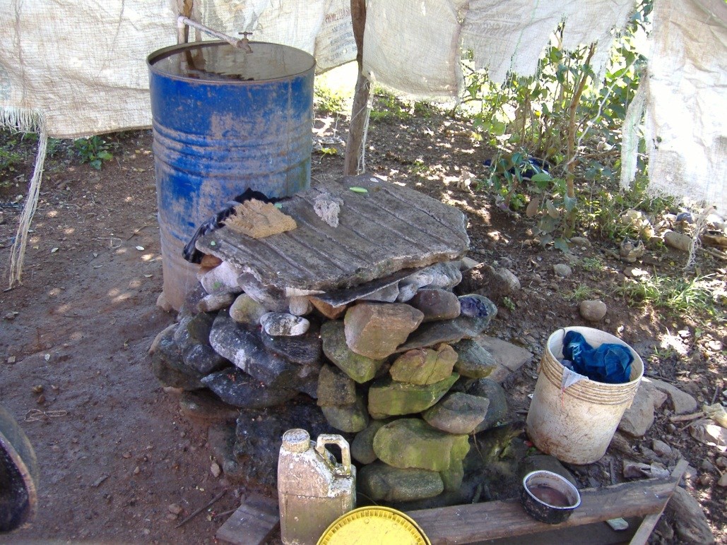
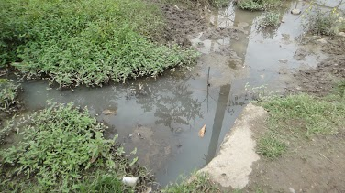
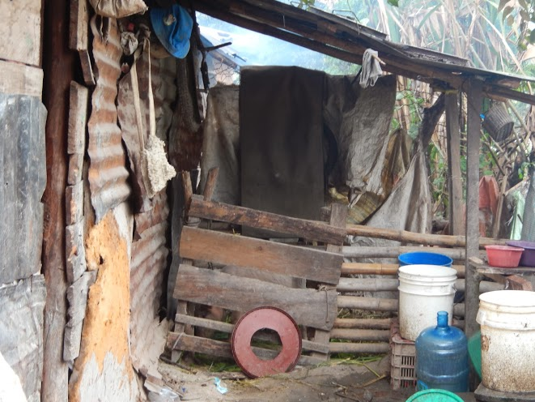
Notes:
I can’t imagine living in a home with no hot water; yet, Many live with no running water – collecting it from the rain on their roof or from nearby streams.

Slide 3
Notes:
I can’t imagine raising a family in a one room house; yet, Many live in one room homes made of tin & cardboard with tarps to keep out the cold.

Slide 4
Notes:
I can’t imagine cooking without an electric stove; yet, Many cook over a wood fire in their small home with no ventilation.

Slide 5
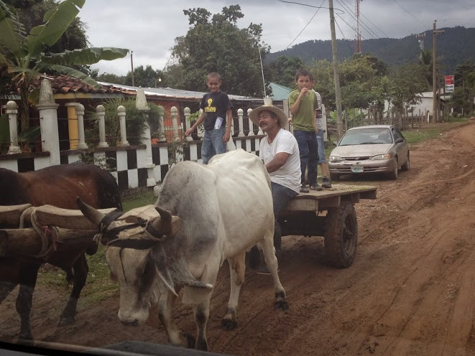
Notes:
I can’t imagine driving without paved streets; yet, Many have only deeply rutted dirt roads & horses or oxen are often used for travel.

Slide 6
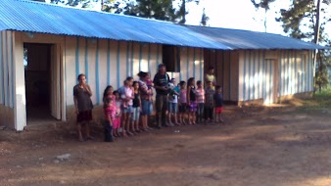
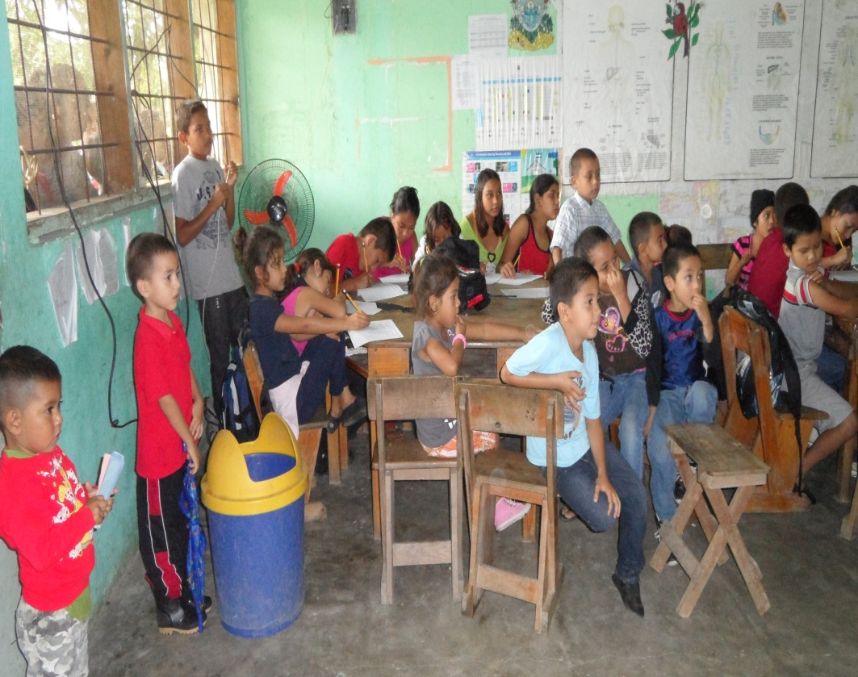
Notes:
I can’t imagine my child attending a school with no A/C; yet, Many walk long distances to schools that may have no roof & have only a single teacher for all grades.

Slide 7
Notes:
I can’t imagine not being able to see our mountains; yet, Many can’t see theirs due to smog from open burning that also causes respiratory illness for many.

Slide 8
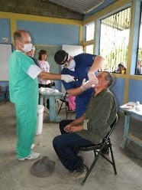
Notes:
I can’t imagine not having immediate access to a doctor; yet, Many have access only once a quarter & wait in line for hours to be seen.

Slide 9
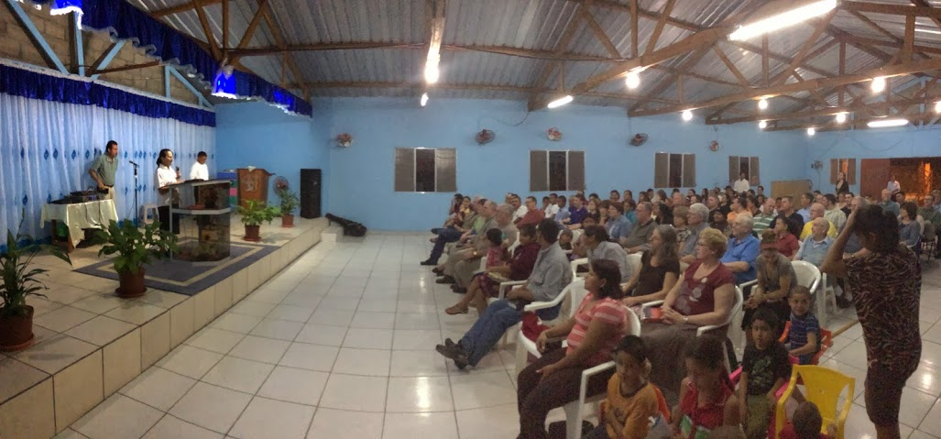
Notes:
These are the people of rural Honduras. There are no government programs to help them; they live in fear of drug cartels and human traffickers; yet, many praise God at church nightly for the blessings they do have.

Slide 10
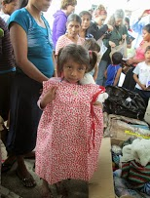
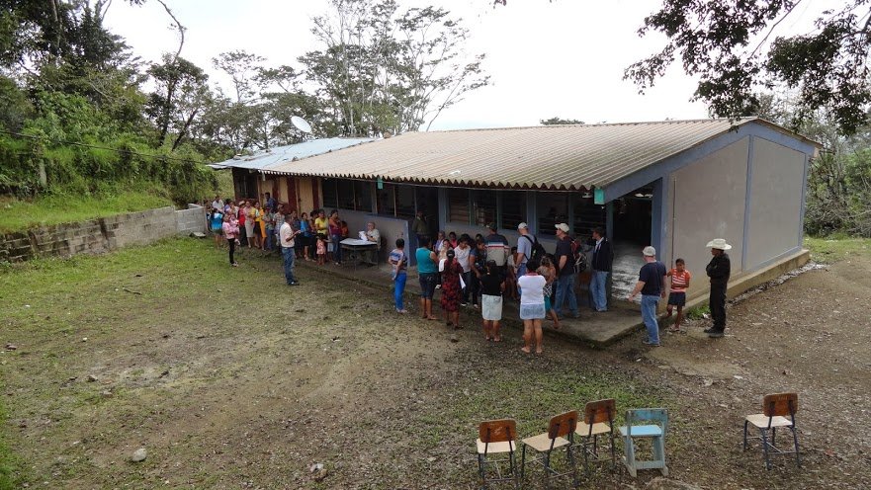
Notes:
The ministry of Cristo Salva offers relief to these people through food & clothing distributions; medical & dental clinics; and school sponsorships.

Slide 11
Notes:
THE TEAM
41 team members: the largest team they have ever had
8 Pastors: The most ever on a trip

Slide 12
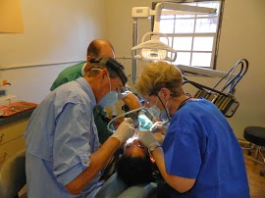
Notes:
466 patients were treated in medical & dental clinics

Slide 13
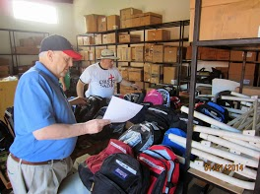
Notes:
300 backpacks filled with school supplies & uniforms were distributed

Slide 14
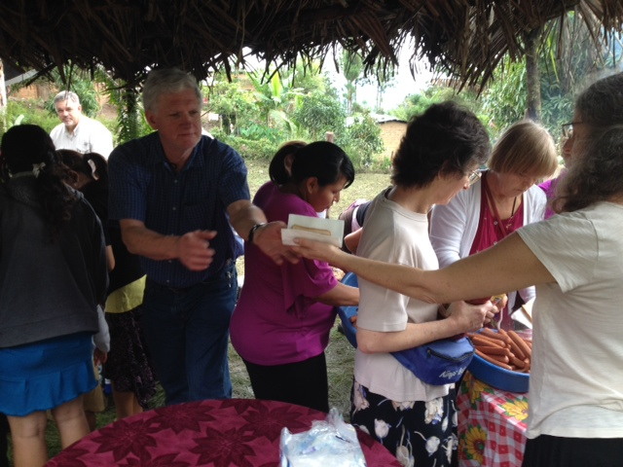
Notes:
200 hotdogs were served in Las Pilas

Slide 15
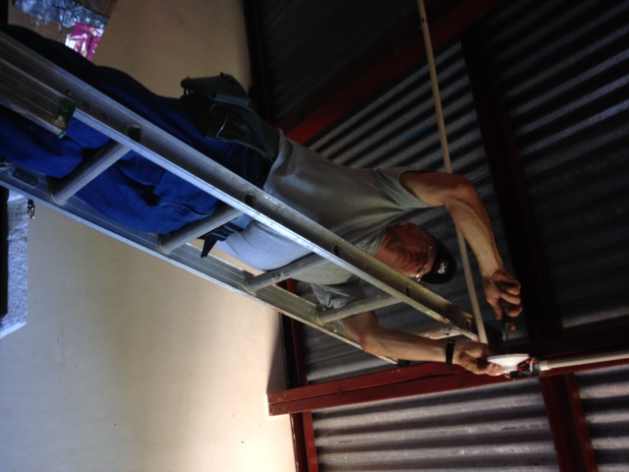
Notes:
Electrical work was completed at the clinic and bodega

Slide 16
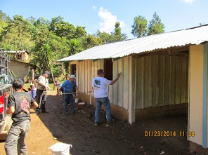
Notes:
School interior & exterior was painted

Slide 17
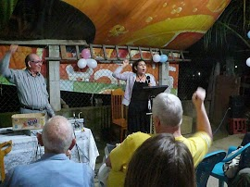
Notes:
Worshipped in 6 different churches & held 3 Sunday School classes

Slide 18
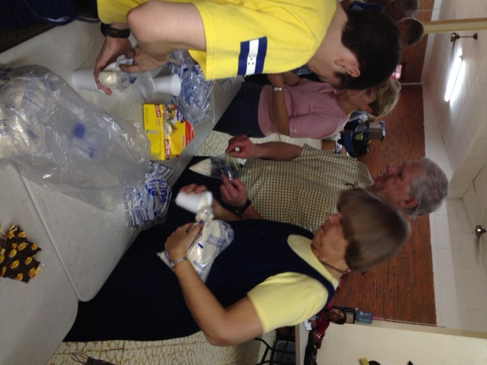
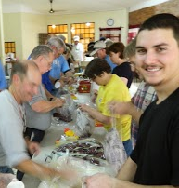
Notes:
Distributed food to families in several different communities

Slide 19
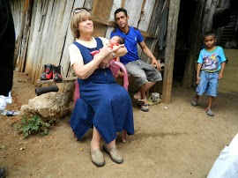
Notes:
Visited numerous homes in different communities

Slide 20
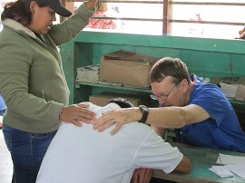
Notes:
“These numbers only reflect part of the story – countless lives were touched for the kingdom this week. Many received prayer and encouragement to make Jesus Lord of their lives.” - Carol Kline

Slide 21
Notes:
Money, supplies & people are needed to sustain this ministry. If you are interested in helping, visit their website at www.cristosalva.org for information.

